Slide 1
Vector Fields
Mohammad H. Chaghazardi
Fall – winter 2011

Slide 2
In this presentation:
1. The physics of the problem
2. The coding of the problem
3. The Graphics of the problem

Slide 3
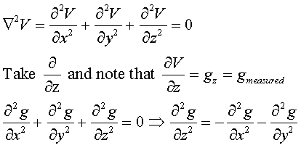
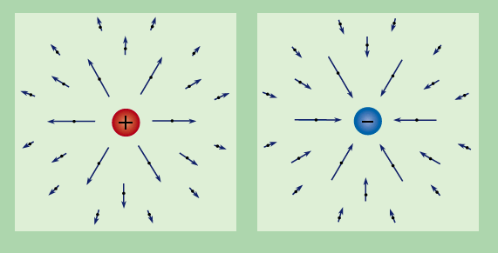
The Physics

Slide 4
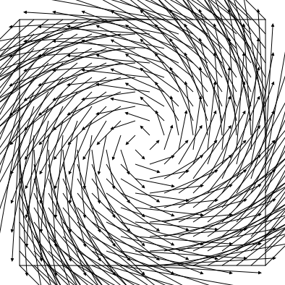
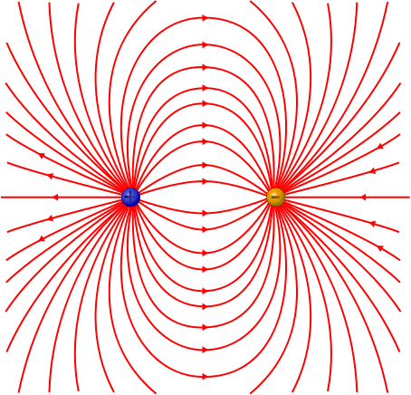
The Physics
Field Drawing styles

Slide 5
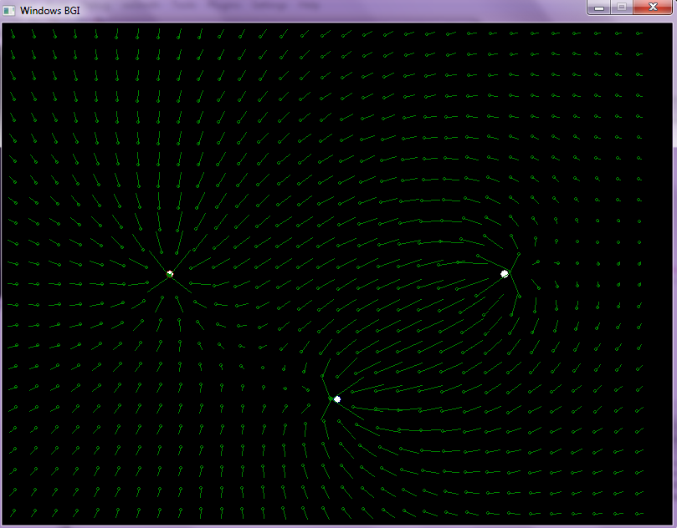
The Physics
Statics

Slide 6
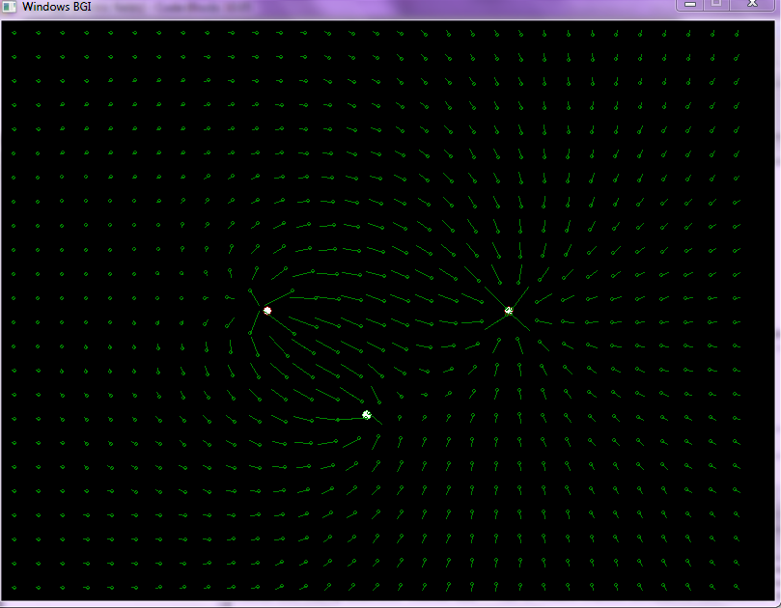
The Physics
Moving charge
Highest Accuracy

Slide 7
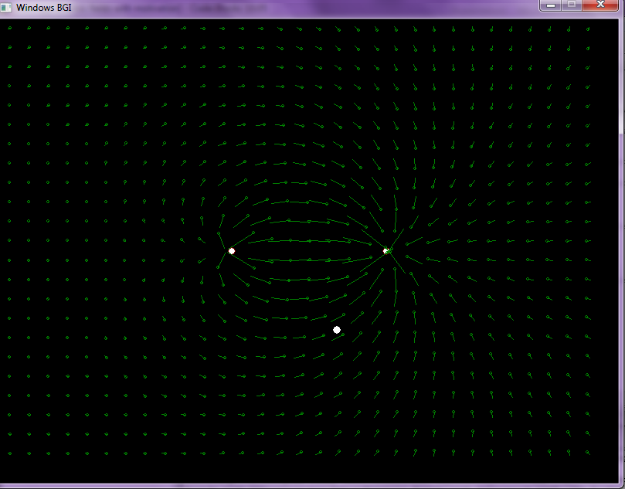
The Physics
Stray Charge

Slide 8
The Code
Using Arrays instead of Vectors
Function calling
draw function
Scan function ( causes undesired delays)
Super Position function (numerical process)
…

Slide 9
The Graphics
Turbo C ! Dream era
Borland 5
GNU or DEV + Graphics and winBGIm libraries

Slide 10
The Graphics
Type 1
How to Draw an Animation ?
FAIL !
Drawing the Plot
Using the circle and line statements
Showing the Plot
Picturing Delays
Clearing the Plot
Using cleardevice ( ) function
Drawing again!

Slide 11
The Graphics
Type 2
How to Draw an Animation ?
FAIL !
Drawing a Plot
Using the circle and line statements
Showing the Plot
Picturing Delays
Drawing an inverse for the Plot
Drawing again!

Slide 12
The Graphics
Type 3
How to Draw an Animation ?
Use of pages in BGi
PASS !

Slide 13
The Graphics
Type 3
How to Draw an Animation ?
Showing Page 1 : setvisualpage ( int x)
Selecting Page 2 : setactivepage( int x)
Drawing Page 2
Showing Page 2
Selecting Page 1
Clearing Page 1
Drawing Page 1 or 2
Goto 1

